Slide 1
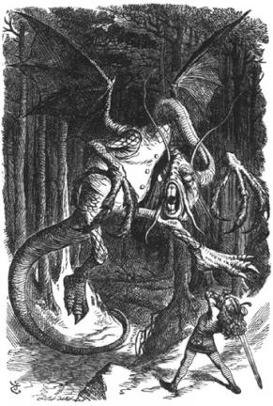
JABBERWOCKY
What is Going on in this Poem?

Slide 2

Jabberwocky: In A Nutshell
This whole poem is nonsense.
Wait, what?
No, it's true. "Jabberwocky" is, in all probability, the most famous nonsense poem ever written in English. The vast majority of the words in this poem are clever inventions of its author. This makes sense if you consider the fact that it was originally published in its entirety in the 1871 book Through the Looking-Glass, and what Alice Found There by Lewis Carroll. Does that sound familiar? It should. With its companion piece, Alice's Adventures in Wonderland, "Jabberwocky" is the basis for the wildly popular Disney movie Alice in Wonderland.
The poem itself was originally just the first stanza, and was published in a magazine that Carroll put together for family and friends. He entitled that first stanza "Stanza of Anglo-Saxon Poetry." Here Carroll was decidedly tongue-in-cheek, given that he was not Anglo-Saxon. ("Anglo-Saxon refers to people who lived in England in approximately 600 A.D.).
http://www.shmoop.com/jabberwocky/

Slide 3
Carroll was English, however, and so we tend to think that "Jabberwocky" was influenced both by that Anglo-Saxon verse which he parodies (killing things with swords, heroes on quests, etc.), as well as a few local English legends (the north-English myth of the Lambton Worm is plausible here – it's about a hero that goes and vanquishes a livestock-eating slithery thing). In other words, "Jabberwocky" is part of a larger children's story gone sort-of awry. The nonsense and the rhyming and the fantasy characters all pin this poem down as something your mom or dad might have read you when you were five, but it's much more than that.
Critics have been raving about Carroll for decades. They just love the way that he manages to make his fantastical stories work on both a child's and an adult's level. His stories and poems are funny and whimsical, but they're also complicated, dark, and bitter. Children are entertained by the whimsy and fantasy. As adults, we see these layers of complexity emerge the more we read the work. "Jabberwocky" and the Alice stories were wildly popular in their time, and they're wildly popular now – for good reason.
Carroll's real name, by the way, was Charles Lutwidge Dodgson, and in addition to being one of the greatest and most popular storytellers of his time, he was also an accomplished mathematician, logician, deacon, and photographer. And you thought your schedule was packed.

Slide 4
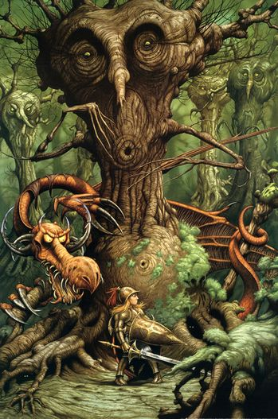
Jabberwocky: Text of the Poem
"And hast thou slain the Jabberwock?
Come to my arms, my beamish boy!
O frabjous day! Callooh! Callay!"
He chortled in his joy.
'Twas brillig, and the slithy toves
Did gyre and gimble in the wabe;
All mimsy were the borogoves,
And the mome raths outgrabe.
'Twas brillig, and the slithy toves
Did gyre and gimble in the wabe;
All mimsy were the borogoves,
And the mome raths outgrabe.
"Beware the Jabberwock, my son
The jaws that bite, the claws that catch!
Beware the Jubjub bird, and shun
The frumious Bandersnatch!"
He took his vorpal sword in hand;
Long time the manxome foe he sought –
So rested he by the Tumtum tree,
And stood awhile in thought.
And, as in uffish thought he stood,
The Jabberwock, with eyes of flame,
Came whiffling through the tulgey wood,
And burbled as it came!
One, two! One, two! And through and through
The vorpal blade went snicker-snack!
He left it dead, and with its head
He went galumphing back.
http://www.shmoop.com/jabberwocky/poem-text.html

Slide 5
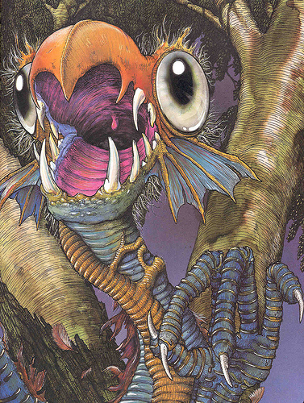
Jabberwocky Brief Summary
The poem begins with a description of the setting – an afternoon, with strange, nonsense-creatures ("borogroves" [3], "raths" [4]) milling around and making noises. Then, we have some dialogue. A father tells his son to beware of something called a "Jabberwocky" that lurks in the woods and has horrible claws and teeth. There's also some other nasty stuff out there – the "Jubjub bird" (7) and the "Bandersnatch" (8). The son takes his sword and goes out looking for these creatures, and finally finds and kills the Jabberwocky. Upon returning with the creature's head, the father is overjoyed and they celebrate. The first stanza repeats, and things appear to return back to normal.
See? It's a simple tale. Just don't get too hung up in the badger-corkscrews (more on them later), and we'll be OK.
http://www.shmoop.com/jabberwocky/summary.html

Slide 6

Fantasy
Fantasy is Carroll's hallmark, and his ability to create an engrossing and thoroughly strange alternate reality puts him in league with writers like Tolkien and C.S. Lewis (and Dr. Seuss). Carroll creates these realities in order to tell us stories that simply can't happen in the real world (fighting dragonish beasts), and to stretch the possibilities of metaphor to their limit. After all, why bother staying in the real world when you have the kind of imagination that can create whole new ones?
Lines 1-2: There's plenty of imagery here, and we know this because the sentence is constructed like an ordinary descriptive sentence ("it was [adjective], and some noun was doing something"), but the words are all jumbly. This is not the world we know – the vocabulary tells us as much.
Line 5: Beware the what? Clearly the speaker here is alluding to some enemy, but like in the majority of the poem, we don't know exactly what it is, or what it's like (other than equipped with rather nasty jaws and claws).
Line 6: More unidentifiable horrible creatures. Clearly, by this point the reader ought to know that these things, and thus the events of the poem, are not of the world we inhabit.
http://www.shmoop.com/jabberwocky/symbolism-imagery.html

Slide 7

Sound & Wordplay
Most of what's going on in this poem is directly sound related. Carroll creates his fantasy world through the use of clever sonic devices and ridiculous vocabulary.
Line 1: Let's take the word slithy as our first example. This word is two things: an example of onomatopoeia, and an example of portmanteau. What's that second one? Well, a portmanteau is a word that's made by squashing two words together. In this case, lithe and slimy. Onomatopoeia, as you might have encountered earlier in the discussion about this poem, refers to a word that sounds like what it means (think hiss or buzz). So we have a word that not only sounds slimy, but also is graceful, because of the inclusion of lithe (which means "supple and/or graceful"). Both the sound and the word combining give this new word force and depth of meaning.
Line 2-3: Gimble and mimsy echo each other (technically, it's assonance, i.e., repeated vowel sounds) creating sonic cohesion, while the light i sounds give us a feeling of carefree-ness and peace.
Line 5: The word Jabberwock is harsh, and signals an impending violence. To jab also means to hit something, which further enhances the sense that this thing is something you don't want to mess with.
Line 8: Similarly, the word Bandernsatch has hints of both bandit and snatch in it, the latter being something that the former would do (a bandit snatches your stuff and runs away with it).
Line 18: Snicker-snack! is also sonically resonant, as it mimics the sound of a sword hitting something. And about the sword: the word vorpal is a onomatopoetic, if you think about it. Say "vorp!" Doesn't this sound like the swinging of a big, powerful weapon?
Line 23: The expressions of joy here are all sound-play. Frabjous is a bit like fabulous, and if you were to holler "Callooh! Callay!" people would probably think you were cheering.
http://www.shmoop.com/jabberwocky/symbolism-imagery.html

Slide 8
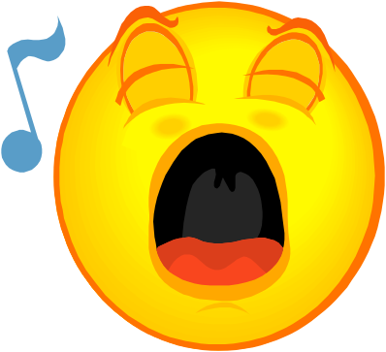
Rhyme, Form, and Meter: Ballad Stanza
Ballad Stanza
This poem, for all its whimsy, is mighty regular. "Jabberwocky" is written solely in quatrains (four-line stanzas) that have a regular ABAB, CDCD, EFEF rhyme scheme. The lines themselves are mostly written in iambic tetrameter. That's a lot of syllables, so let's look at the first lines with the accents all marked out:
'Twas brill-ig, and the sli-thy toves
Did gyre and gim-ble in the wabe
Do you notice how there are four stressed syllables in each line, and that they alternate neatly with unstressed syllables, with the unstressed syllable coming first? That's iambic tetrameter for you. The iambic bit refers to the unstressed-STRESSED, unstressed-STRESSED rhythm of it, and the tetrameter bit is just to let you know that there are four iambs (or four unstressed-STRESSED groupings) in each line.
The only irregularity in the rhythm itself is the fact that the last line of each stanza only has three stresses, making it iambic trimeter. (See: "and came ga-lumph-ing back.") But it's still OK to call this poem Ballad Stanza, because ballad stanza isn't the world's most regular form. It can be alternating tetrameter and trimeter, and its rhyme scheme can be ABAB or ABBA or ABCB. It's flexible.
What's a ballad? The short answer is that it's a song. Ballad stanza is traditionally found in folktale songs, and is used as a way for people to communicate legends and tales to each other orally. It's rhythm and rhyme make it easy to remember for this reason. Even though it has some crazy language, "Jabberwocky" is no exception. Because it has the memorable rhythm and rhyme, "Jabberwocky" remains one of the most frequently memorized poems in the English language. Amazing, no?
http://www.shmoop.com/jabberwocky/rhyme-form-meter.html

Slide 9
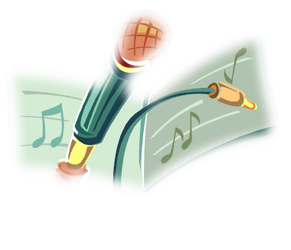
Sound Check
The lilting rhythm of "Jabberwocky" helps the narrator's cause. It makes the poem easy to remember (so that he can tell it to you around that campfire), and it keeps the story moving forward at a regular clip. (Think: "and THEN and THEN and THEN and THEN!")
All the exclamation points in the middle are what give our storyteller his cues to gesticulate wildly at us while relaying the epic battle, and so even though the rhythm stays constant, we have some good changes in volume.
Speaking of volume, there's also all this wonderful onomatopoeia – that is, words that sound like their definition (think "hiss" and "buzz"). Phrases like "snicker-snack!" (18) and "whiffling" (15) and "galumphing" (20) and "chortled" (25) (the last two of which are officially recognized English words now) give us sound cues that help us not only see, but hear the events going on in the poem. After all, it's a nonsense poem – the words were mostly chosen or made up for their sound, not their sense.
Wow – after all this, "Jabberwocky" might be the ultimate "Sound Check" poem.
http://www.shmoop.com/jabberwocky/sound-check.html

Slide 10


What’s Up With the Title?
Just like most epics with a central character, "Jabberwocky" is simply titled after the most significant thing in the poem – the giant monster foe. The title of this poem forces us to reckon with the monster as the central force of the poem. It shifts our attention to the monster, and away from our anonymous hero.
But why not the hero, à la Beowulf? Well, our hero doesn't have a name. (The why of this is a study question, so we'll leave it up to you to ponder Sir Hero's anonymity.)
http://www.shmoop.com/jabberwocky/title.html

Slide 11
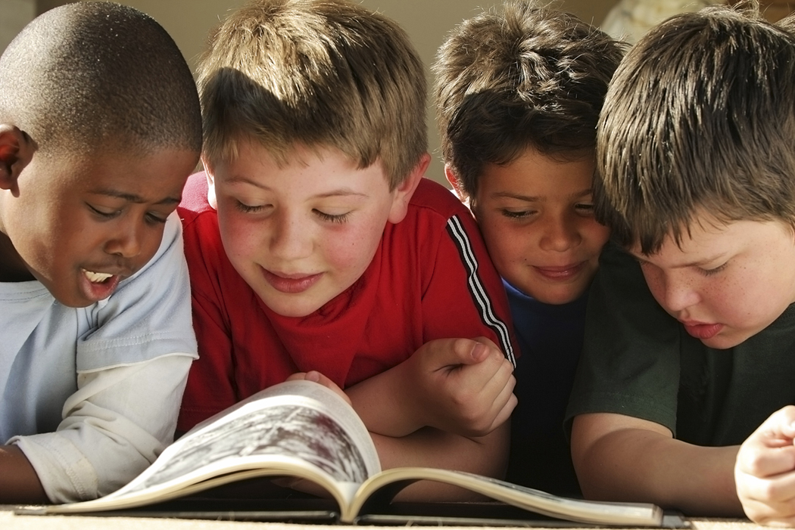
What Did you find for Themes?
There are a number of different themes that can be found in this poem.
Turn to your neighbor and share one theme you found!

Slide 12
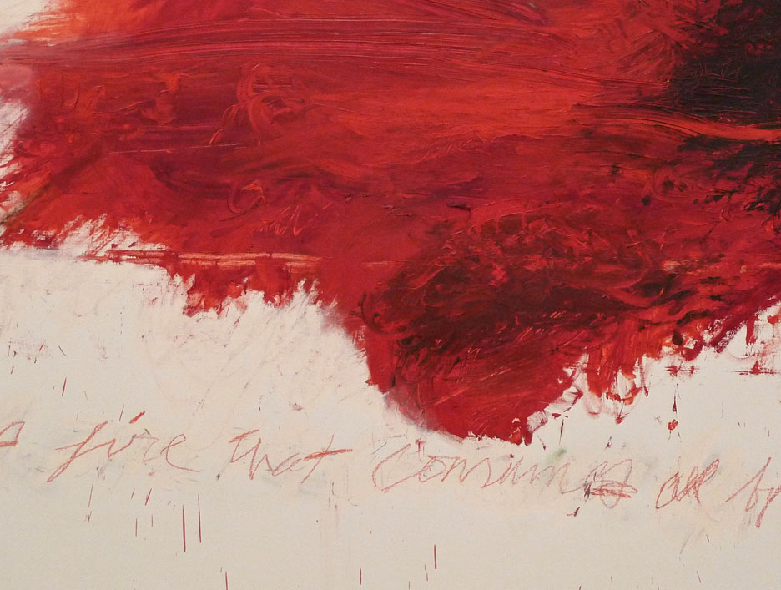
Violence is Good
The climax of "Jabberwocky" is violent indeed – a hallmark of the "epic ballad" form, of which this poem is a tiny sample. The warnings in the second stanza of the poem set up the danger, which is quickly followed up by the protagonist heading directly off to rid the forest of the wild and unseemly creatures that are described. Not only does the hero vanquish the most fearsome of his foes, but he also beheads him, dragging the bloody thing back in order to prove his might to his father. The violence here plays to our desire for good to stomp evil right into the ground.
http://www.shmoop.com/jabberwocky/violence-theme.html

Slide 13
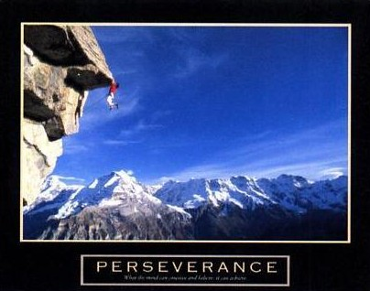
One Must Persevere
In keeping with the "epic" scope of the poem, our protagonist's journey is no walk in the park. In order to triumph, he must first persevere. This theme is related to the theme of "Men and Masculinity" – it almost seems as if the protagonist has something to prove, as he hears his father's warnings and promptly goes out to find and vanquish the badness that lurks beyond. He seeks and seeks, and though we don't have a sense of the temporal element of the his journey (after all, we only get 28 lines), our hero's determination pays off. He's rewarded, as one might expect, with a joyous homecoming.
http://www.shmoop.com/jabberwocky/perseverance-theme.html

Slide 14
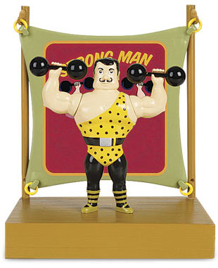
Men Must Be Manly
Carroll first published a bit of "Jabberwocky" as a kind of satire of Anglo-Saxon verse, which might well be the "manliest" poetry there is (in addition to being the earliest in English). Think Beowulf: a man goes out to fight a monster. While it's more complicated than that, Beowulf set the tone for centuries to come, and Carroll knew it. "Jabberwocky" is all about conquest, which has traditionally been considered the domain of the masculine. The fact that the protagonist, after hearing the dire warnings given him by his father, picks up his sword and heads out into the woods anyway, is one of those brave-but-maybe-unreasonable things that heroes tend to do in adventure tales. "Jabberwocky" is no exception.
http://www.shmoop.com/jabberwocky/men-masculinity-theme.html

Slide 15
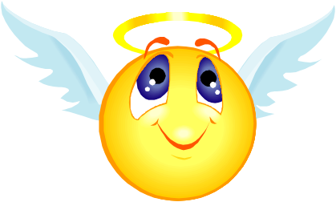
In Good Vs. Evil, Good will Win
In "Jabberwocky," "Good vs. Evil" is linked with the theme of "Violence." When good (our hero) and evil (the Jabberwock) meet in this story, violence ensues. "Jabberwocky" pits the individual (one lone man) against a mythical beast. Since this beast doesn't exist in our world, it becomes something bigger, a kind of metaphor for Evil with a capital E. If it were simply human vs. human – say, white knight vs. black knight – you could draw the same conclusions, but perhaps the outcome would be less surprising. One small man triumphing over a big huge beast is an order of magnitude unto itself.
http://www.shmoop.com/jabberwocky/good-vs-evil-theme.html

Slide 16
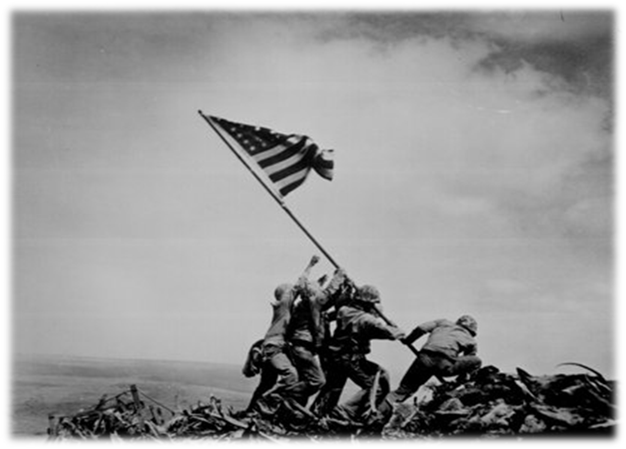
Man will Conquer the Natural World
"Man and the Natural World" might be the most interesting subject in the whole poem, because it's the one subject in which we can bring in the goofy language. How, you ask? Well, the "natural world" that Carroll creates certainly doesn't seem to have anything to do with the "natural world" that we inhabit, yet there are many similarities between the world of the Jubjub bird and the world of the ordinary owl. Carroll's positioning of hero vs. beast is essentially the age-old story of Man vs. Nature. While the subject "Good vs. Evil" also figures into "Jabberwocky," the Evil in this case is basically Stuff We Are Afraid Of In the Woods. Even the first peaceful stanza is full of unknowable, strange creatures doing unknowable, strange things. And they get significantly less peaceful when they return in the second stanza, because not all the evil has been banished.
http://www.shmoop.com/jabberwocky/man-the-natural-world-theme.html

